Slide 1
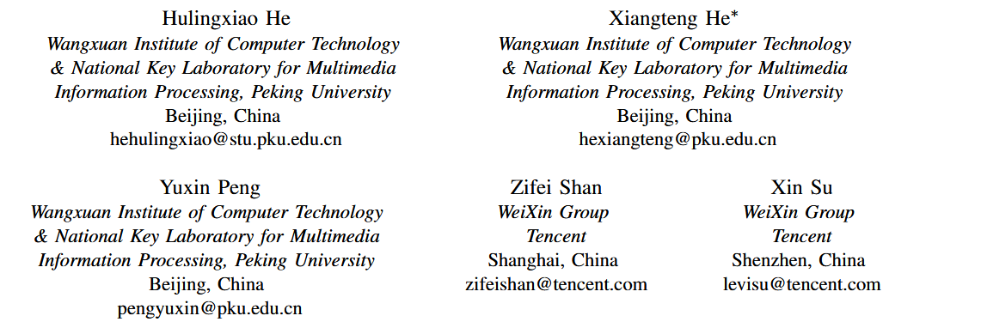
ATAI
Advanced Technique of Artificial Intelligence
ATAI
ChongqingUniversity _{AdvancedTechniqueof}
of Technology Artificial Intelligence
Chongqing University of
Technology
Chongqing University ^{ATAI}
_{of Technology} Advanced Techniqueof
Artificial Intelligence
Chongqing University of Technology
Chongqing University of Technology
Firzen: Firing Strict Cold-Start Items with Frozen Heterogeneous and Homogeneous Graphs for Recommendation
https://github.com/PKU-ICST-MIPL/Firzen ICDE2024
——ICDE2024
Reported by Jingbo Liu
1

Slide 2
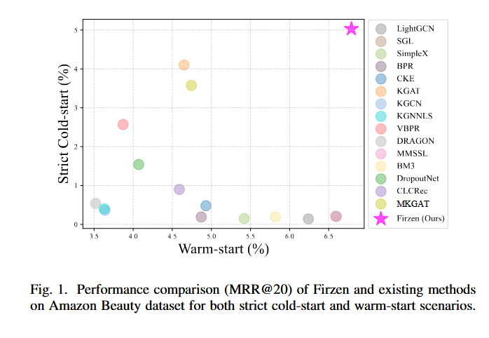
ATAI
Advanced Technique of Artificial Intelligence
ATAI
ChongqingUniversity _{AdvancedTechniqueof}
of Technology Artificial Intelligence
Chongqing University of
Technology
Chongqing University ^{ATAI}
_{of Technology} Advanced Techniqueof
Artificial Intelligence
Chongqing University of Technology
Chongqing University of Technology
Motivate
Some fail to learn the embedding of a strict cold-start item since side information is only utilized to enhance the warm-start ID representations

Slide 3
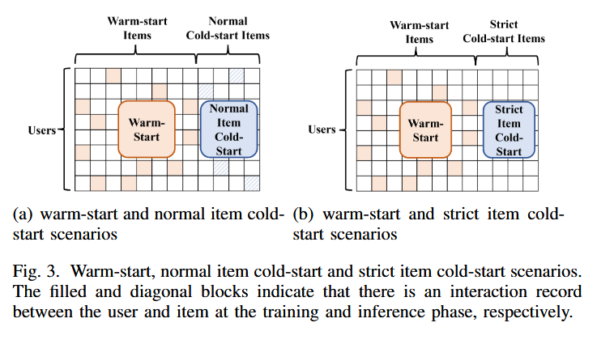
ATAI
Advanced Technique of Artificial Intelligence
ATAI
ChongqingUniversity _{AdvancedTechniqueof}
of Technology Artificial Intelligence
Chongqing University of
Technology
Chongqing University ^{ATAI}
_{of Technology} Advanced Techniqueof
Artificial Intelligence
Chongqing University of Technology
Chongqing University of Technology
Motivate
Some fail to learn the embedding of a strict cold-start item since side information is only utilized to enhance the warm-start ID representations

Slide 4
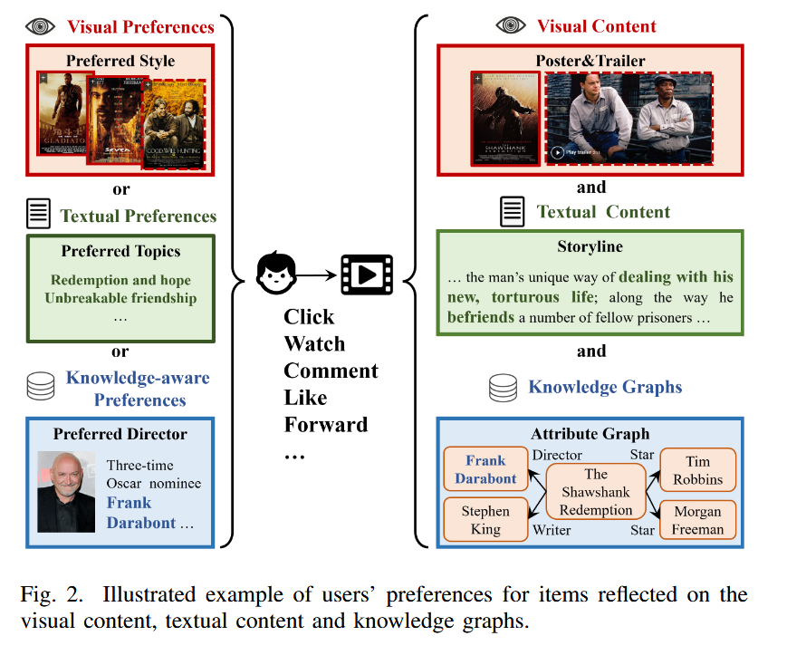
ATAI
Advanced Technique of Artificial Intelligence
ATAI
ChongqingUniversity _{AdvancedTechniqueof}
of Technology Artificial Intelligence
Chongqing University of
Technology
Chongqing University ^{ATAI}
_{of Technology} Advanced Techniqueof
Artificial Intelligence
Chongqing University of Technology
Chongqing University of Technology
Motivate
The others deteriorate the performance of warm-start recommendation since unrelated multi-modal content or entities in KGs may blur the final representations

Slide 5
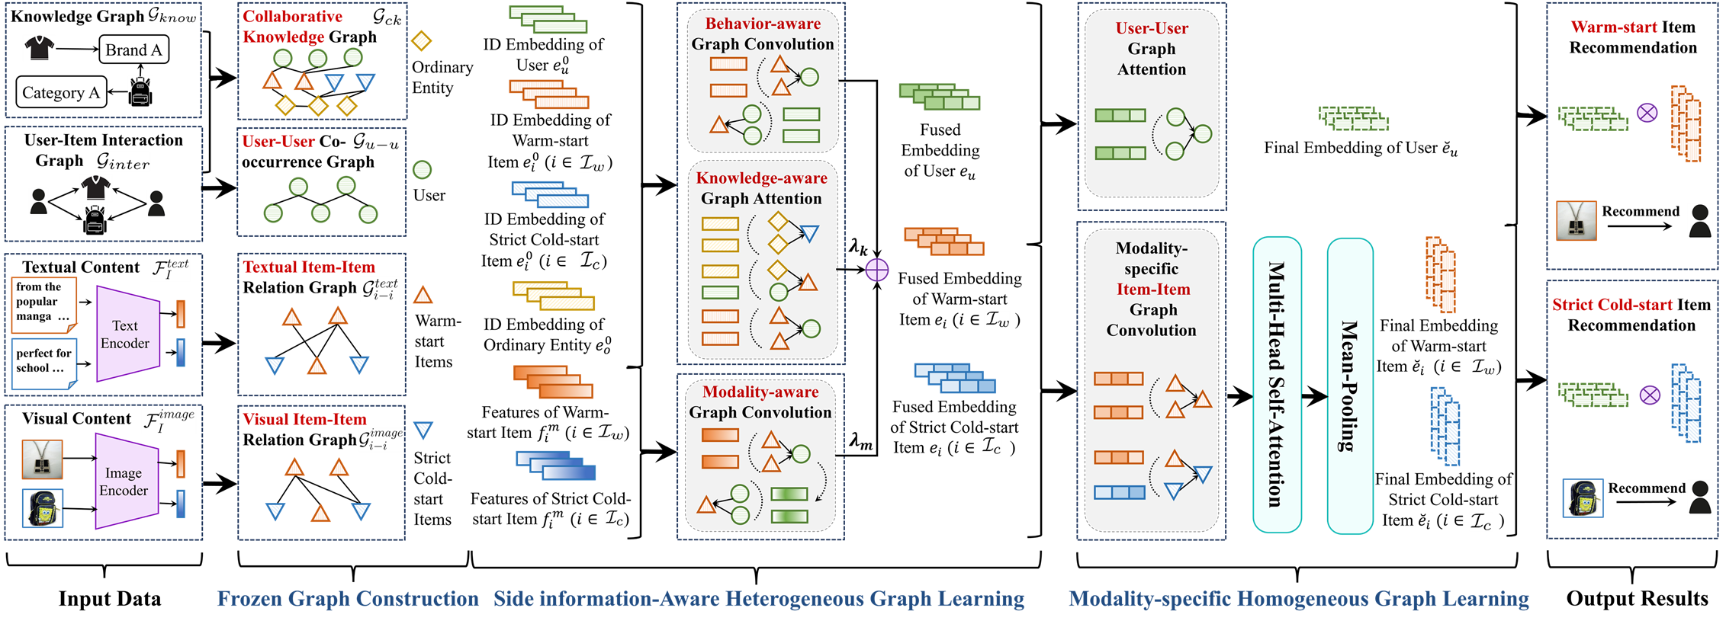
ATAI
Advanced Technique of Artificial Intelligence
ATAI
ChongqingUniversity _{AdvancedTechniqueof}
of Technology Artificial Intelligence
Chongqing University of
Technology
Chongqing University ^{ATAI}
_{of Technology} Advanced Techniqueof
Artificial Intelligence
Chongqing University of Technology
Chongqing University of Technology
Method

Slide 6
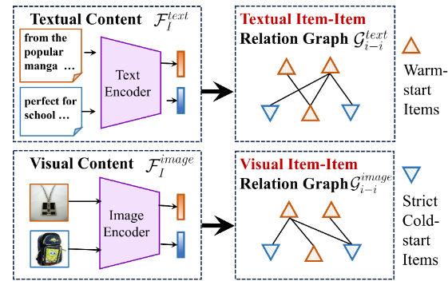
ATAI
Advanced Technique of Artificial Intelligence
ATAI
ChongqingUniversity _{AdvancedTechniqueof}
of Technology Artificial Intelligence
Chongqing University of
Technology
Chongqing University ^{ATAI}
_{of Technology} Advanced Techniqueof
Artificial Intelligence
Chongqing University of Technology
Chongqing University of Technology
Method

Slide 7
ATAI
Advanced Technique of Artificial Intelligence
ATAI
ChongqingUniversity _{AdvancedTechniqueof}
of Technology Artificial Intelligence
Chongqing University of
Technology
Chongqing University ^{ATAI}
_{of Technology} Advanced Techniqueof
Artificial Intelligence
Chongqing University of Technology
Chongqing University of Technology
Method

Slide 8
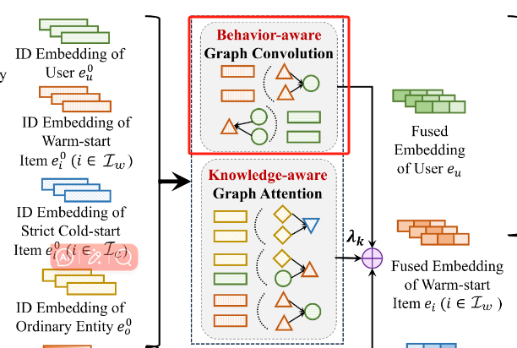
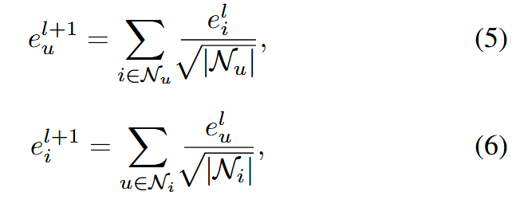
ATAI
Advanced Technique of Artificial Intelligence
ATAI
ChongqingUniversity _{AdvancedTechniqueof}
of Technology Artificial Intelligence
Chongqing University of
Technology
Chongqing University ^{ATAI}
_{of Technology} Advanced Techniqueof
Artificial Intelligence
Chongqing University of Technology
Chongqing University of Technology
Method

Slide 9
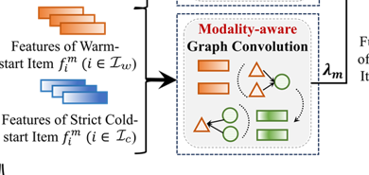
ATAI
Advanced Technique of Artificial Intelligence
ATAI
ChongqingUniversity _{AdvancedTechniqueof}
of Technology Artificial Intelligence
Chongqing University of
Technology
Chongqing University ^{ATAI}
_{of Technology} Advanced Techniqueof
Artificial Intelligence
Chongqing University of Technology
Chongqing University of Technology
Method

Slide 10
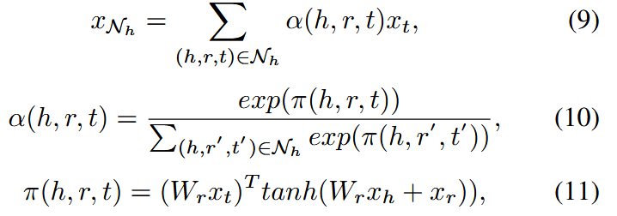
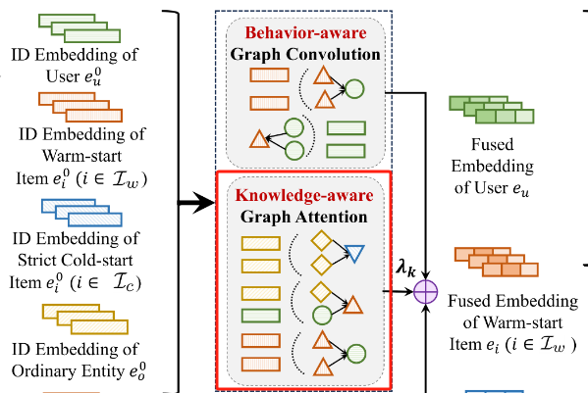
ATAI
Advanced Technique of Artificial Intelligence
ATAI
ChongqingUniversity _{AdvancedTechniqueof}
of Technology Artificial Intelligence
Chongqing University of
Technology
Chongqing University ^{ATAI}
_{of Technology} Advanced Techniqueof
Artificial Intelligence
Chongqing University of Technology
Chongqing University of Technology
Method

Slide 11
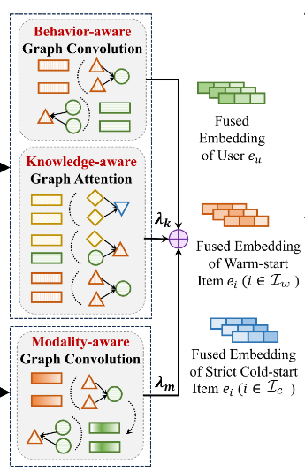
ATAI
Advanced Technique of Artificial Intelligence
ATAI
ChongqingUniversity _{AdvancedTechniqueof}
of Technology Artificial Intelligence
Chongqing University of
Technology
Chongqing University ^{ATAI}
_{of Technology} Advanced Techniqueof
Artificial Intelligence
Chongqing University of Technology
Chongqing University of Technology
Method

Slide 12
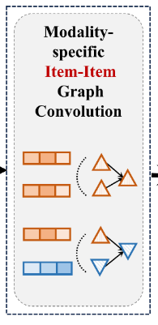
ATAI
Advanced Technique of Artificial Intelligence
ATAI
ChongqingUniversity _{AdvancedTechniqueof}
of Technology Artificial Intelligence
Chongqing University of
Technology
Chongqing University ^{ATAI}
_{of Technology} Advanced Techniqueof
Artificial Intelligence
Chongqing University of Technology
Chongqing University of Technology
Method

Slide 13
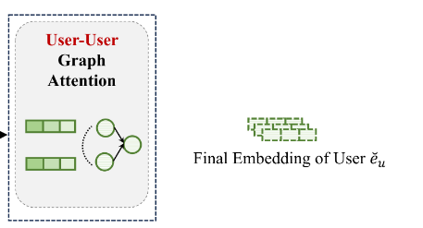
ATAI
Advanced Technique of Artificial Intelligence
ATAI
ChongqingUniversity _{AdvancedTechniqueof}
of Technology Artificial Intelligence
Chongqing University of
Technology
Chongqing University ^{ATAI}
_{of Technology} Advanced Techniqueof
Artificial Intelligence
Chongqing University of Technology
Chongqing University of Technology
Method

Slide 14
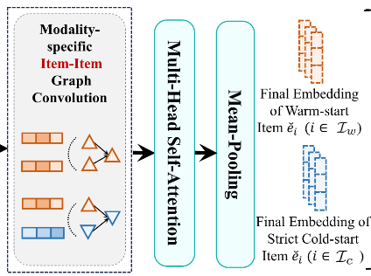
ATAI
Advanced Technique of Artificial Intelligence
ATAI
ChongqingUniversity _{AdvancedTechniqueof}
of Technology Artificial Intelligence
Chongqing University of
Technology
Chongqing University ^{ATAI}
_{of Technology} Advanced Techniqueof
Artificial Intelligence
Chongqing University of Technology
Chongqing University of Technology
Method

Slide 15
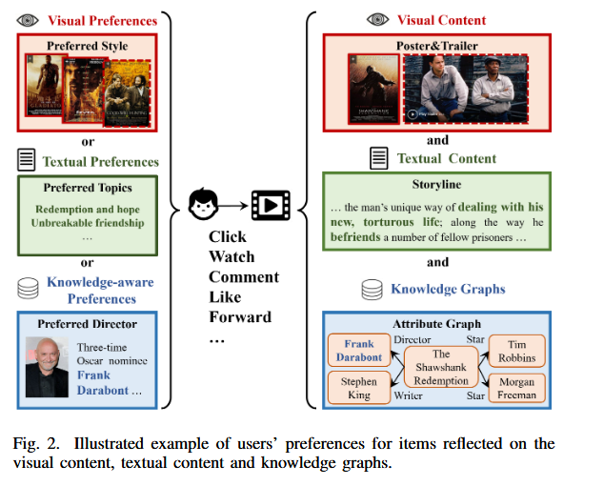
ATAI
Advanced Technique of Artificial Intelligence
ATAI
ChongqingUniversity _{AdvancedTechniqueof}
of Technology Artificial Intelligence
Chongqing University of
Technology
Chongqing University ^{ATAI}
_{of Technology} Advanced Techniqueof
Artificial Intelligence
Chongqing University of Technology
Chongqing University of Technology
Method

Slide 16
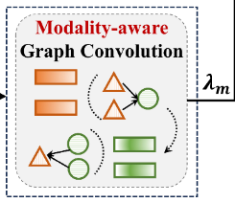
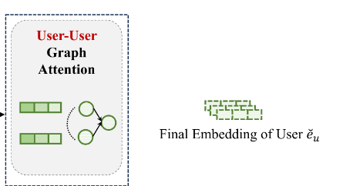
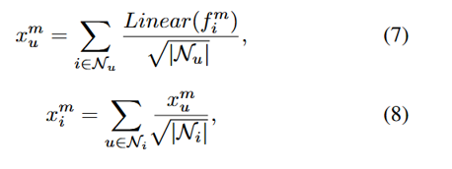
ATAI
Advanced Technique of Artificial Intelligence
ATAI
ChongqingUniversity _{AdvancedTechniqueof}
of Technology Artificial Intelligence
Chongqing University of
Technology
Chongqing University ^{ATAI}
_{of Technology} Advanced Techniqueof
Artificial Intelligence
Chongqing University of Technology
Chongqing University of Technology
Method

Slide 17
ATAI
Advanced Technique of Artificial Intelligence
ATAI
ChongqingUniversity _{AdvancedTechniqueof}
of Technology Artificial Intelligence
Chongqing University of
Technology
Chongqing University ^{ATAI}
_{of Technology} Advanced Techniqueof
Artificial Intelligence
Chongqing University of Technology
Chongqing University of Technology
Method

Slide 18
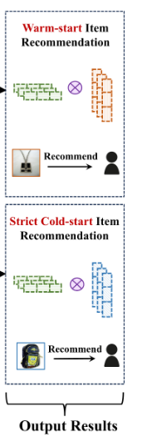
ATAI
Advanced Technique of Artificial Intelligence
ATAI
ChongqingUniversity _{AdvancedTechniqueof}
of Technology Artificial Intelligence
Chongqing University of
Technology
Chongqing University ^{ATAI}
_{of Technology} Advanced Techniqueof
Artificial Intelligence
Chongqing University of Technology
Chongqing University of Technology
Method

Slide 19
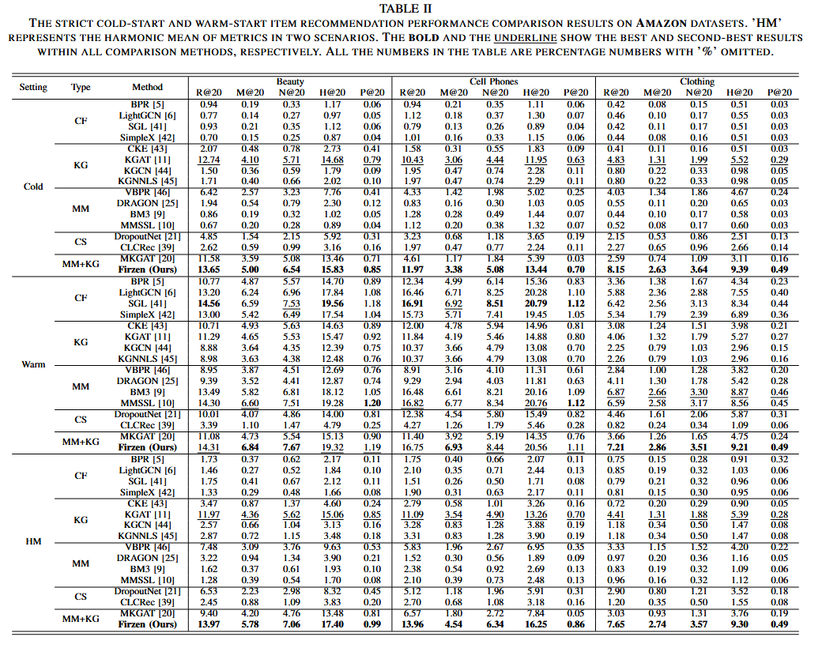
Chongqing University of Technology
Chongqing University of Technology

Slide 20
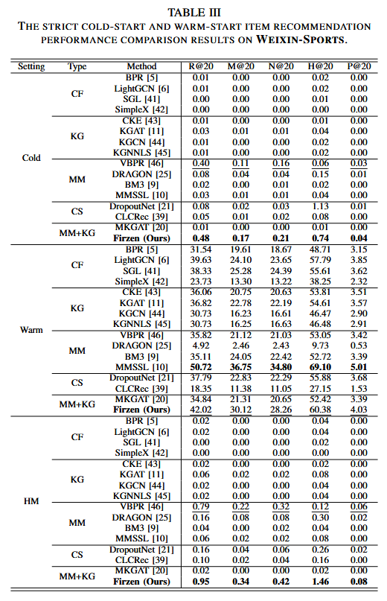

Slide 21
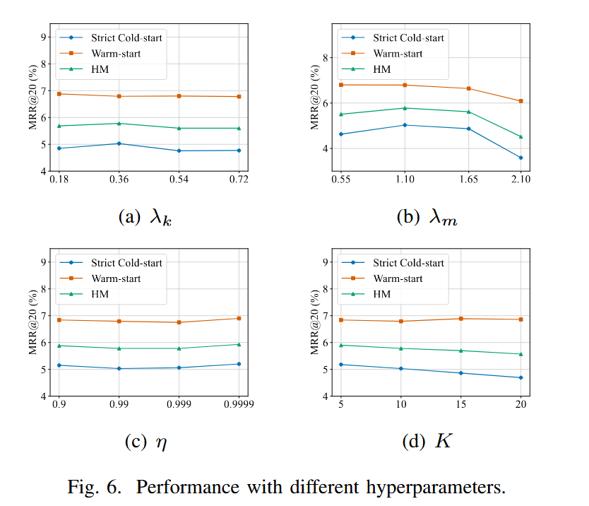
ATAI
Advanced Technique of Artificial Intelligence
ATAI
ChongqingUniversity _{AdvancedTechniqueof}
of Technology Artificial Intelligence
Chongqing University of
Technology
Chongqing University ^{ATAI}
_{of Technology} Advanced Techniqueof
Artificial Intelligence
Chongqing University of Technology
Chongqing University of Technology
Experiments

Slide 22
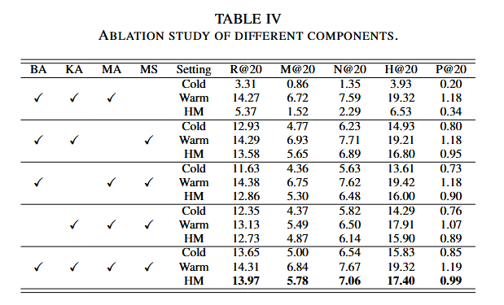
ATAI
Advanced Technique of Artificial Intelligence
ATAI
ChongqingUniversity _{AdvancedTechniqueof}
of Technology Artificial Intelligence
Chongqing University of
Technology
Chongqing University ^{ATAI}
_{of Technology} Advanced Techniqueof
Artificial Intelligence
Chongqing University of Technology
Chongqing University of Technology
Experiments

Slide 23
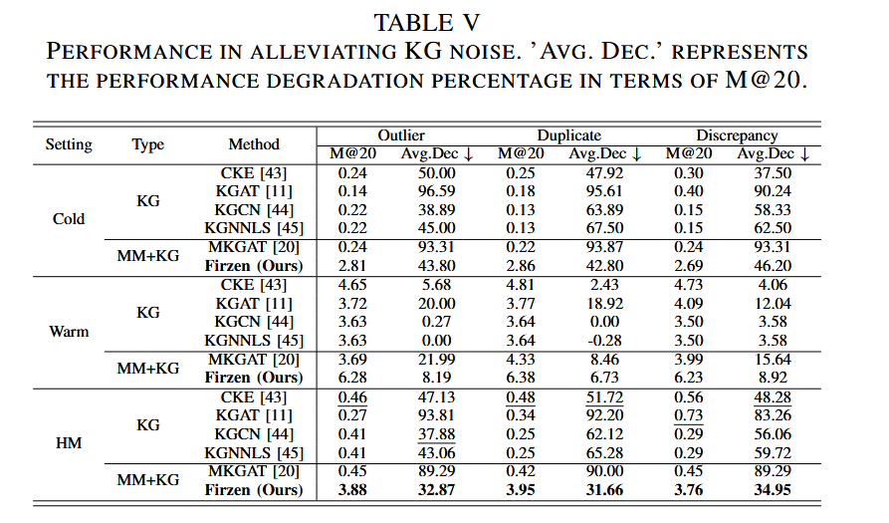
ATAI
Advanced Technique of Artificial Intelligence
ATAI
ChongqingUniversity _{AdvancedTechniqueof}
of Technology Artificial Intelligence
Chongqing University of
Technology
Chongqing University ^{ATAI}
_{of Technology} Advanced Techniqueof
Artificial Intelligence
Chongqing University of Technology
Chongqing University of Technology
Experiments

Slide 24
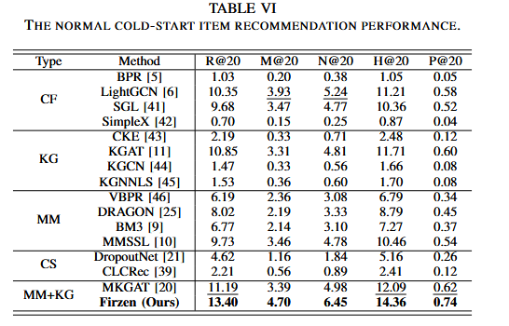
ATAI
Advanced Technique of Artificial Intelligence
ATAI
ChongqingUniversity _{AdvancedTechniqueof}
of Technology Artificial Intelligence
Chongqing University of
Technology
Chongqing University ^{ATAI}
_{of Technology} Advanced Techniqueof
Artificial Intelligence
Chongqing University of Technology
Chongqing University of Technology
Experiments

Slide 25
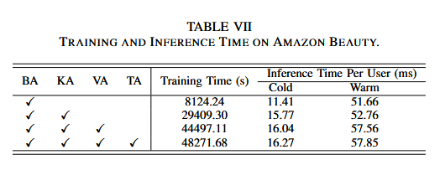
ATAI
Advanced Technique of Artificial Intelligence
ATAI
ChongqingUniversity _{AdvancedTechniqueof}
of Technology Artificial Intelligence
Chongqing University of
Technology
Chongqing University ^{ATAI}
_{of Technology} Advanced Techniqueof
Artificial Intelligence
Chongqing University of Technology
Chongqing University of Technology
Experiments

Slide 26
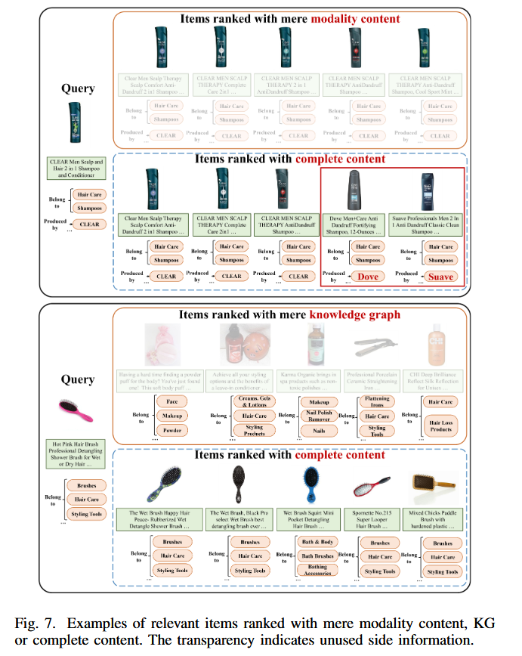
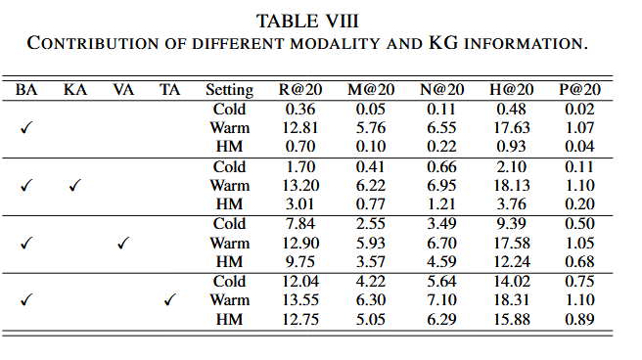
ATAI
Advanced Technique of Artificial Intelligence
ATAI
ChongqingUniversity _{AdvancedTechniqueof}
of Technology Artificial Intelligence
Chongqing University of
Technology
Chongqing University ^{ATAI}
_{of Technology} Advanced Techniqueof
Artificial Intelligence
Chongqing University of Technology
Chongqing University of Technology

Slide 27
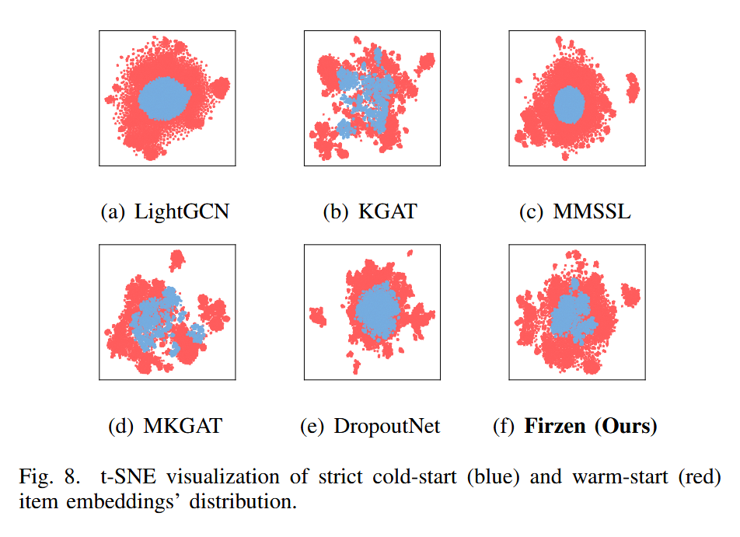
ATAI
Advanced Technique of Artificial Intelligence
ATAI
ChongqingUniversity _{AdvancedTechniqueof}
of Technology Artificial Intelligence
Chongqing University of
Technology
Chongqing University ^{ATAI}
_{of Technology} Advanced Techniqueof
Artificial Intelligence
Chongqing University of Technology
Chongqing University of Technology
Experiments

Slide 28
ATAI
Advanced Technique of Artificial Intelligence
ATAI
ChongqingUniversity _{AdvancedTechniqueof}
of Technology Artificial Intelligence
Chongqing University of
Technology
Chongqing University ^{ATAI}
_{of Technology} Advanced Techniqueof
Artificial Intelligence
Chongqing University of Technology
Chongqing University of Technology
Thanks!

